Slide 1
Continuous Monitoring
SE489: DevOps Engineering

Slide 2
Outline
Why we need Continuous Monitoring?
What is Continuous Monitoring?
Continuous Monitoring Tools
What is Nagios?
Nagios Case Study

Slide 3
Why we need Continuous Monitoring?

Slide 4
Why we need Continuous Monitoring?
Failure of CI/CD Pipelines
Application Issues
Infrastructure Issues
Static Code Analysis

Slide 5
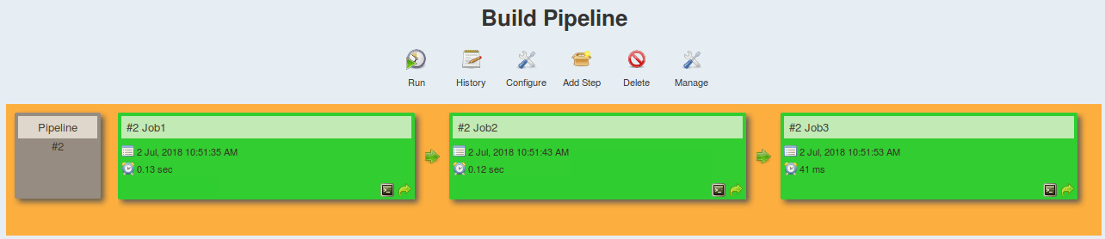
Why we need Continuous Monitoring?
Issues with CI/CD Pipelines:
Rapid introduction of performance problems and errors
Rapid introduction of new endpoints causing monitoring issues
Lengthy root cause analysis as the number of services expands

Slide 6
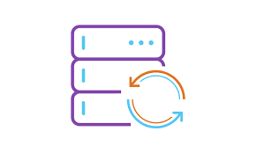

Why we need Continuous Monitoring?
</>
Running APM solutions earlier in lifecycle
Production-like Environment
Feedback of how application will perform in production
Taking corrective actions

Slide 7

Why we need Continuous Monitoring?
Server health cannot be compromised at any cost
Increase response time

Slide 8

Why we need Continuous Monitoring?
Static code analysis will give insights about your code

Slide 9
What is Continuous Monitoring?

Slide 10
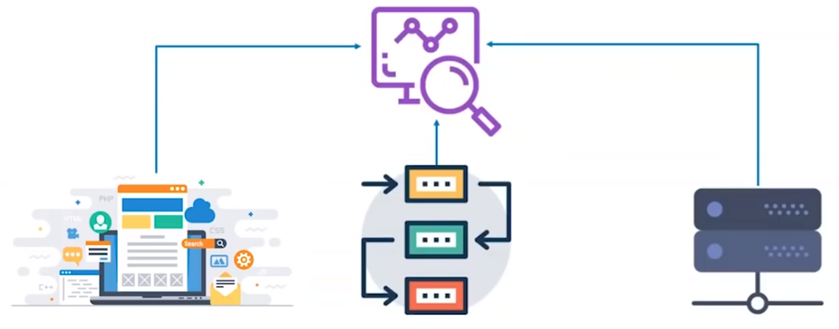
What is Continuous Monitoring?
Effective comprehensive monitoring approach is essential for visibility of your application and Infrastructure

Slide 11
What is Continuous Monitoring?
Continuous monitoring is the process of identifying threats to the security and compliance rules of a software development cycle and architecture.
Helps business and technical teams determine and interpret analytics to solve crucial issues
Help enterprises acquire data from various ecosystems
It is a fully automated procedure

Slide 12
Continuous Monitoring Aim
Strengthen the transparency of the ecosystem
Monitor and resolve issues
Identify and resolve performance inconsistencies and error sources
Assist companies in keeping a tab of their user experience

Slide 13
Types of Continuous Monitoring
Infrastructure Monitoring
Nagios and Prometheus
Application Monitoring
Datadog and Splunk
Network Monitoring
Wireshark and NMap

Slide 14
Benefits of Continuous Monitoring
Better security
Automate many security measures.
Performance errors are detected earlier
Help determine performance inconsistencies
System downtime is significantly reduced
Keep a vigilant eye on the database, network, and applications, helping to resolve any issues before they give rise to system downtime
Facilitates better performance for the business
By alleviating system downtimes, it improves user experience and business credibility

Slide 15
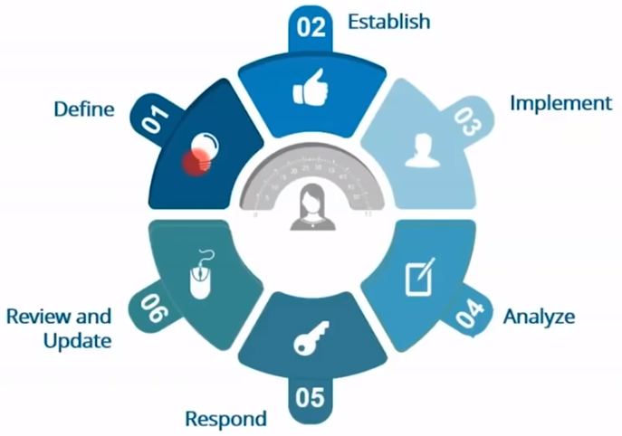
Continuous Monitoring Phases - NIST

Slide 16
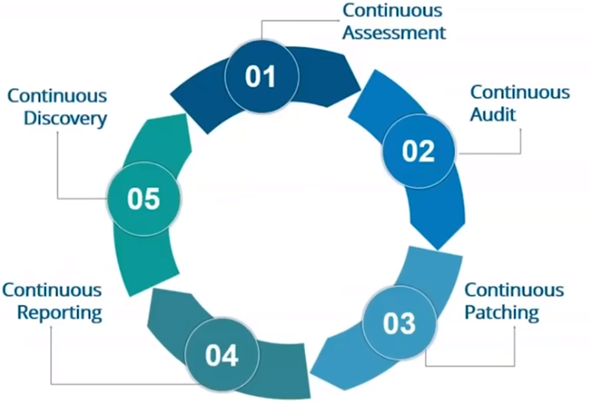
Continuous Monitoring Phases - Patriot

Slide 17
Continuous Monitoring Tools

Slide 18






Continuous Monitoring Tools

Slide 19
What is Nagios?

Slide 20
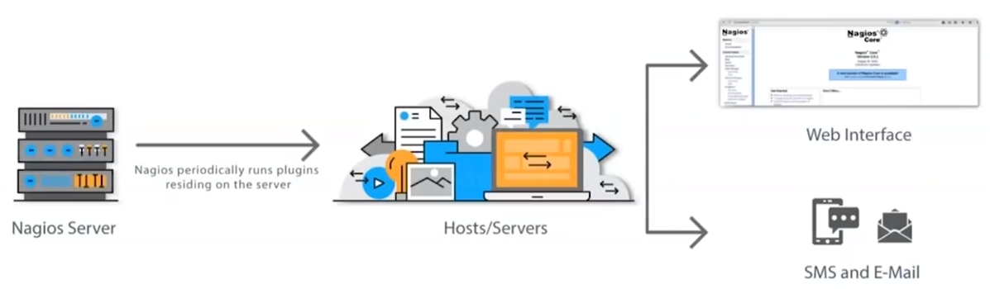
What is Nagios?
Nagios monitors your entire IT infrastructure to ensure systems, applications, services, and business processes are functioning properly.

Slide 21
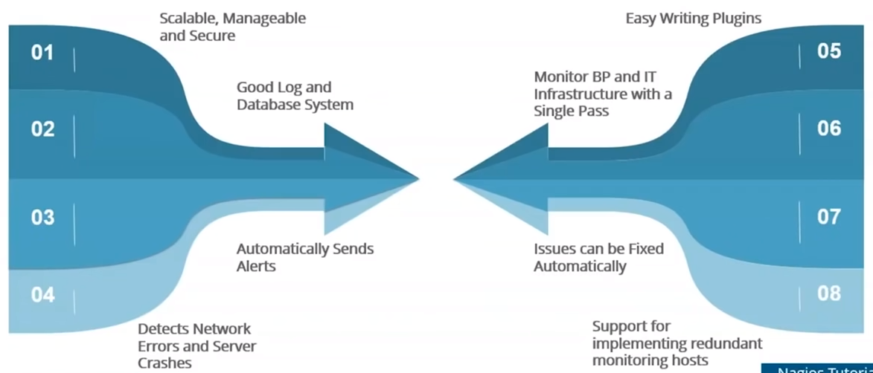
Nagios Features

Slide 22
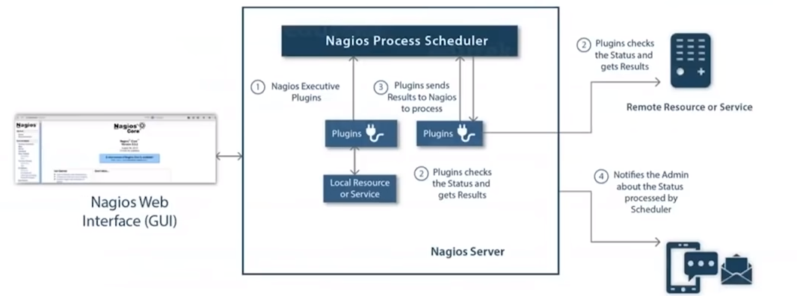
Nagios Architecture
Nagios is built on server/agents architecture
Nagios server is running on a host, and plugins interact with local and remote nodes
Plugins will send information to the Scheduler

Slide 23
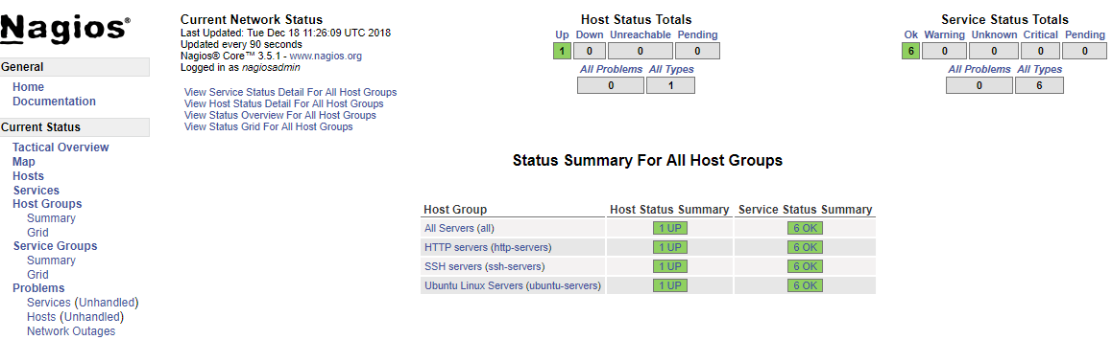
Nagios Dashboard

Slide 24
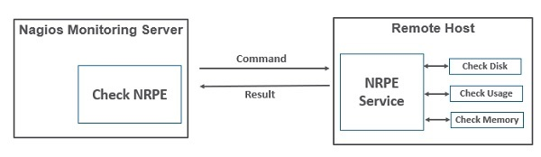
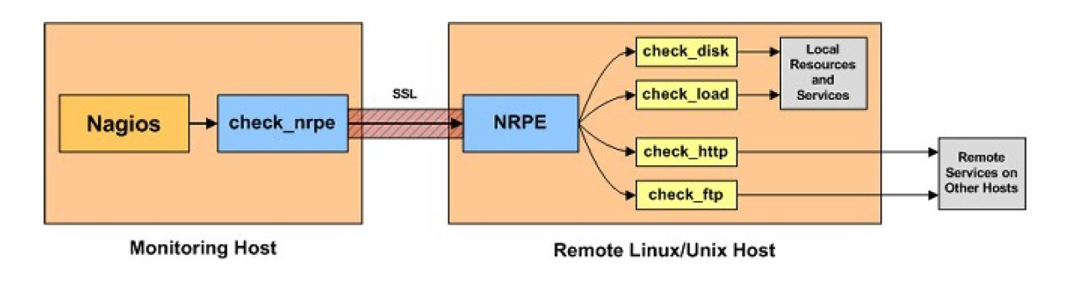
Monitoring Remote Linux Hosts

Slide 25
Nagios Case Study

Slide 26
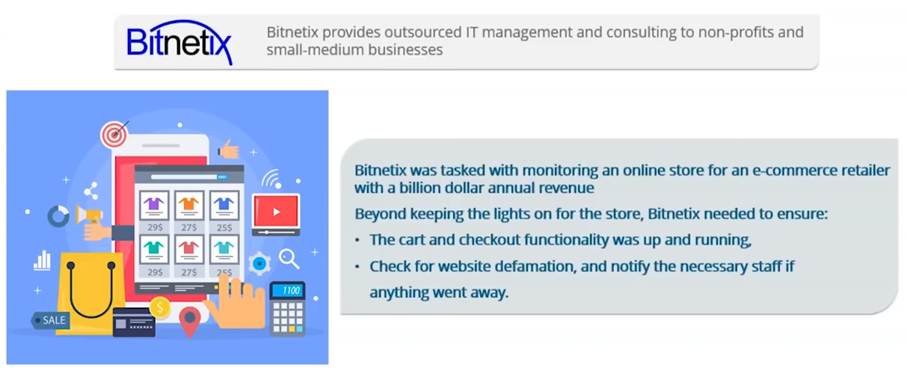
Nagios Case Study - Bitnetix
Bitnetix was tasked with monitoring an online store for an e-commerce retailer with a billion dollar annual revenue.
Beyond keeping the lights on for the store, Bitnetix needed to ensure:
The cart and checkout functionality was up and running
Cehck fro website defamation, and notify yhe necessary staff if anything went away

Slide 27
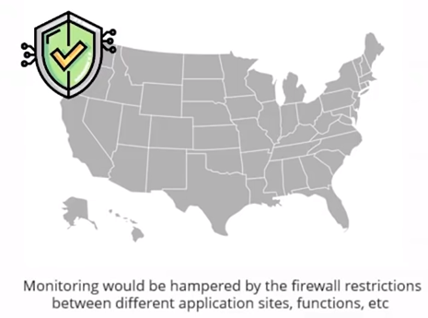

Challenge
Bitnetix hit a roadblock upon realizing that the client's data center was located in Seacacus, New Jersey, more than 500 miles away from their staff in Rochester, NY
Dev
Test
Prod

Slide 28
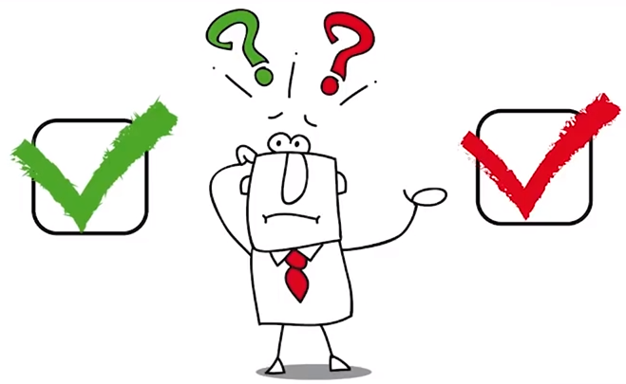
Challenge
Bitnetix hit a roadblock upon realizing that the client's data center was located in Seacacus, New Jersey, more than 500 miles away from their staff in Rochester, NY
Most of the notifications sent to the client were ignored because there were so many false positives

Slide 29
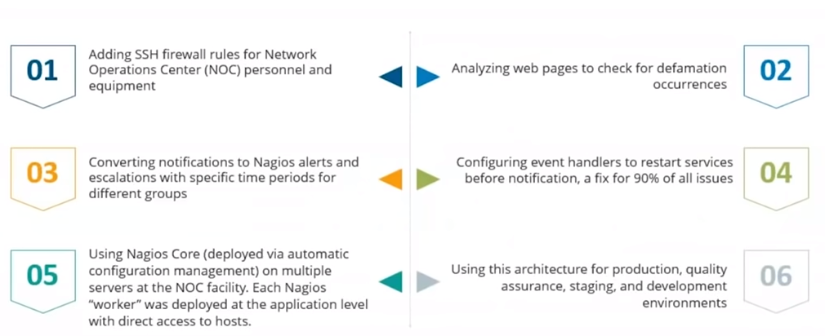
Solution

Slide 30
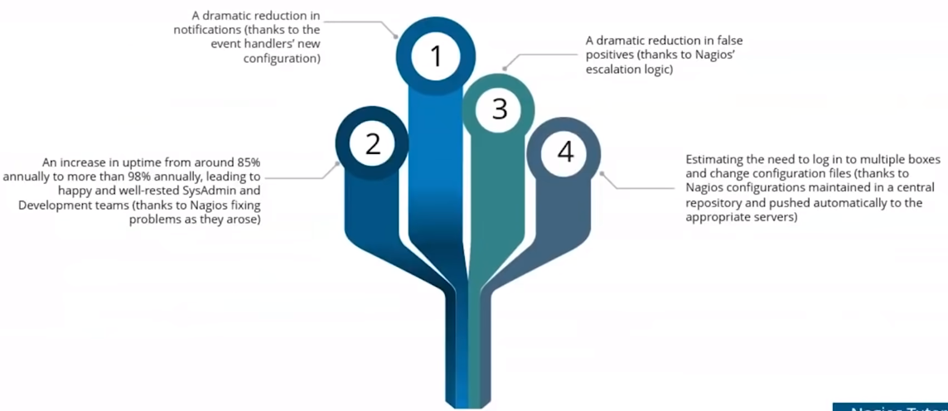
Results

